Slide 1


Joshua
Review Game
How to Play
Read the question, and find the rectangle with the correct answer. Write the letter that matches your answer on a white board, and wait for your teacher to reveal the results. For every correct answer, you will earn one point

Slide 2

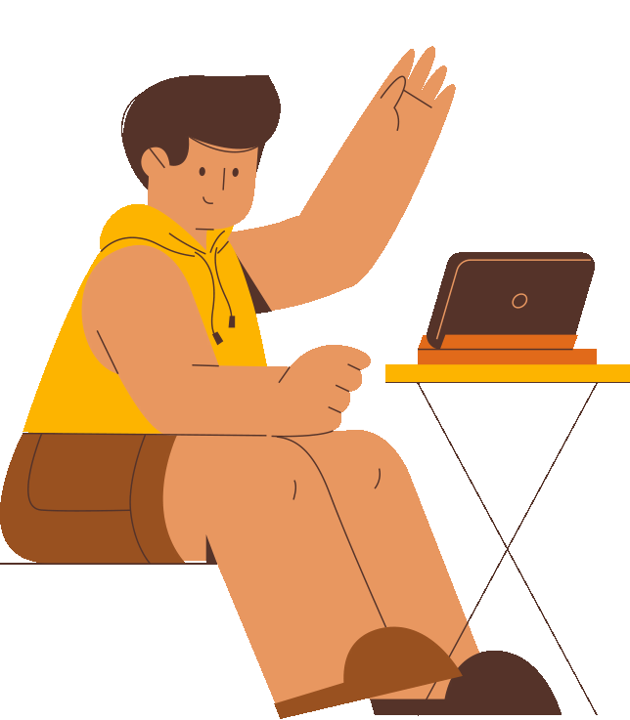
Are you ready to test your knowledge about the book of Joshua?
Let’s get started!

Slide 3
1/15
Who was the leader of Israel before Joshua?
A. Moses
B. Noah
C. Jacob
D. Abraham

Slide 4

Moses

Slide 5
2/15
Who was Joshua’s Father?
A. Moses
B. Nun
C. Aaron
D. Caleb

Slide 6
Nun

Slide 7
3/15
What city’s walls fell after the Israelites marched around them?
A. Jericho
B. Ai
C. Jerusalem
D. Judy

Slide 8
Jericho
Okay, who chose Judy?

Slide 9
4/15
What river did the Israelites cross to enter the Promised Land?
A. Nile
B. Mississippi
C. Jordan
D. Euphrates

Slide 10
Jordan

Slide 11
How many days did the Israelites march around Jericho before the walls fell?
5/15
A. 1
B. 7
C. 5
D. 100

Slide 12
7

Slide 13
6/15
What did the priests carry while marching around Jericho?
A. Swords
B. Horns
C. Flags
D. Snacks

Slide 14
Horns

Slide 15
7/15
Who helped the Israelite spies in Jericho?
A. Ruth
B. Potiphar
C. Mary
D. Rahab

Slide 16
Rahab

Slide 17
8/15
What did God tell Joshua to be strong and courageous about?
A. Building a temple
B. Fighting Goliath
C. Leading His people
D. Everything

Slide 18
Leading His people

Slide 19
9/15
How many kings did Joshua defeat in Canaan?
A. 3
B. 13
C. 15
D. 31

Slide 20
31

Slide 21
10/15
What was set up as a memorial after crossing the Jordan?
A. a statue
B. 12 stones
C. a banner
D. a well

Slide 22
12 stones

Slide 23
11/15
What happened to the sun during one of the battles?
A. it got brighter
B. it stopped
C. it dissapeared
D. it wiggled

Slide 24
it stopped

Slide 25
12/15
What did Joshua tell the Israelites to choose?
A. their leaders
B. their land
C. who they’d serve
D. a favorite color

Slide 26
who they would serve

Slide 27
13/15
What was the final command Joshua gave to the Israelites?
A. be nice
B. remember the Lord
C. settle down
D. conquer more land

Slide 28
Remember the Lord

Slide 29
14/15 SPICY ROUND
Who took some of the forbidden items from battle and hid them?
Write your answer on the board

Slide 30
Achan

Slide 31
15/15 SUPER SPICY ROUND
Who tricked Israel into making a peace treaty by disguise?
Write your answer on the board

Slide 32
The Gibeonites

Slide 33
Thanks for playing
You are so smart! Keep on studying God’s Word and remember
Joshua 1:9

